Slide 1
Unveiling Insights from Salary Survey Data
IS 537-Theory & Prct of Data Cleaning
Sanjana Pai Sinchana S Babu
Vikrant Indi

Slide 2
What is the dataset that is being used?
The dataset being used is a Salary Survey from AskAManager.org.
The dataset primarily focuses on salary-related information but also includes additional demographic and professional details.
The dataset contains 28035 rows and 17 columns.
Notably, 6 of the variables involve free-form text entry.

Slide 3
Where does the dataset come from/who made it?
AskAManager.org is a popular advice column and blog run by Alison Green.
The salary survey is conducted through this platform and collects responses from individuals regarding their salary, job title, industry, location, years of experience, gender, race, and other relevant information.
The dataset is "live" and constantly growing, as new responses are added over time.

Slide 4
What are the attributes of interest?
Age
Industry
Job Title
Annual Salary
Currency
Country
Years of Experience
Gender

Slide 5
Research Questions
Which industry pays the most?
How does salary increase given years of experience?
How do salaries compare for the same role in different locations?
How much do salaries differ by gender and years of experience?
How do factors like education level correlate with salary?
Is there a “sweet spot” total work experience vs years in the specific field?

Slide 6
What is the quality/fitness for use of the dataset?
Relevance to Analysis Goals
Currency Standardization
Domain-Specific Considerations

Slide 7
What has been done to make the dataset fit for use?
Renaming Columns
Dropping Columns
Currency Conversion and Related manipulation
Handling Missing Values
Label Encoding

Slide 8
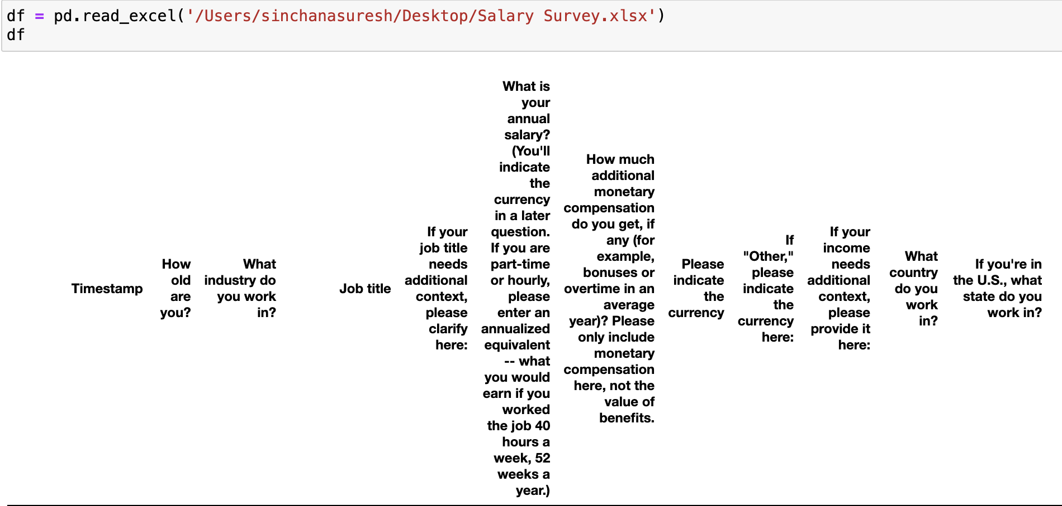
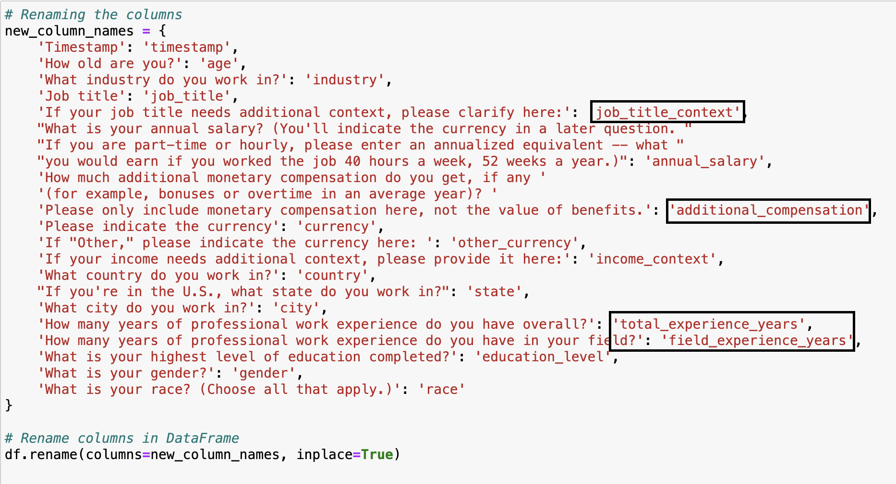
Renaming Columns

Slide 9
Dropping Columns

Slide 10
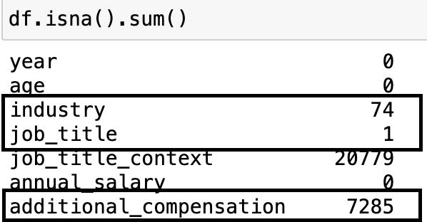
Handling Missing Values

Slide 11
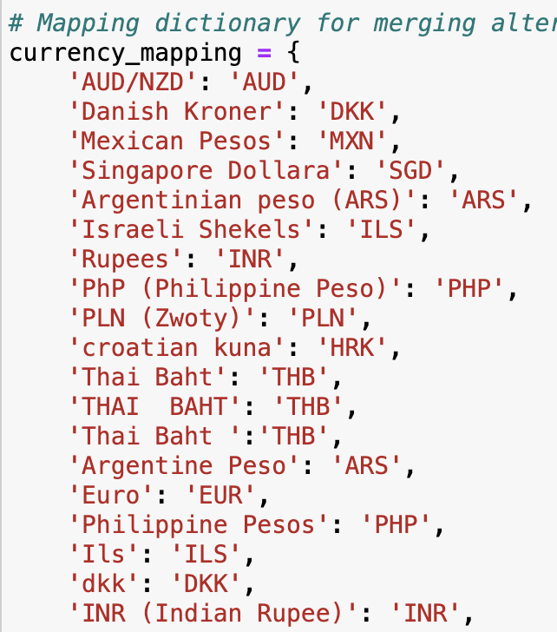
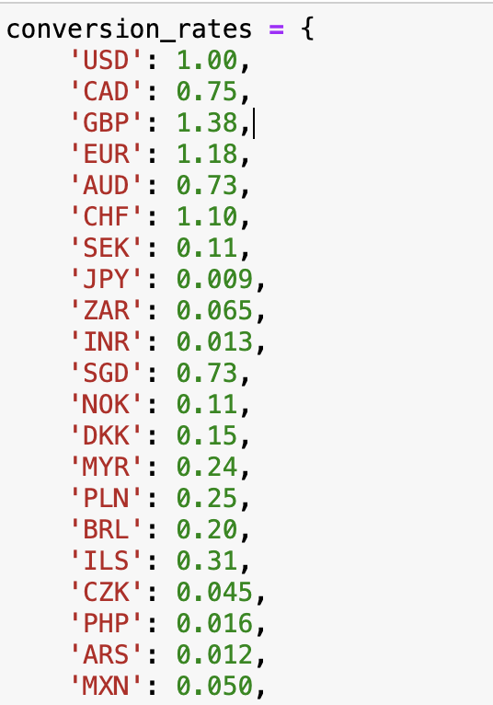
Currency Conversion and Related manipulation

Slide 12
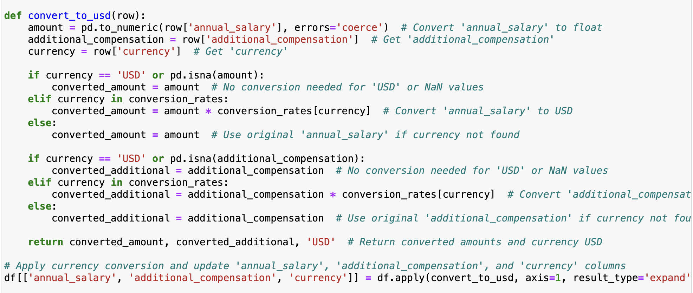

Slide 13
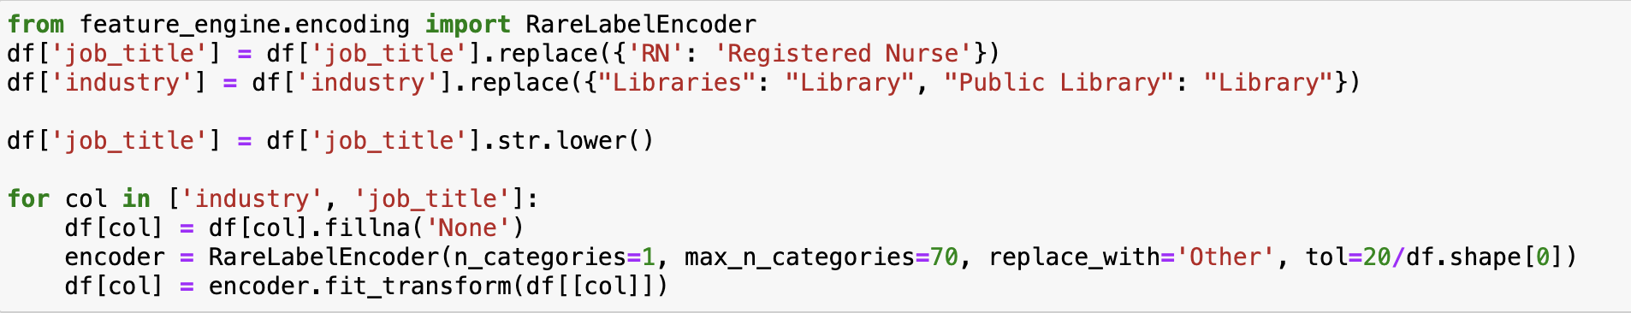
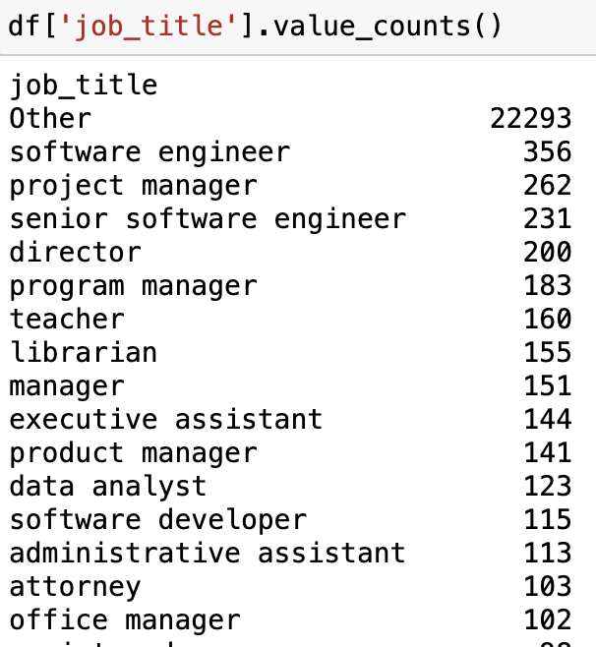
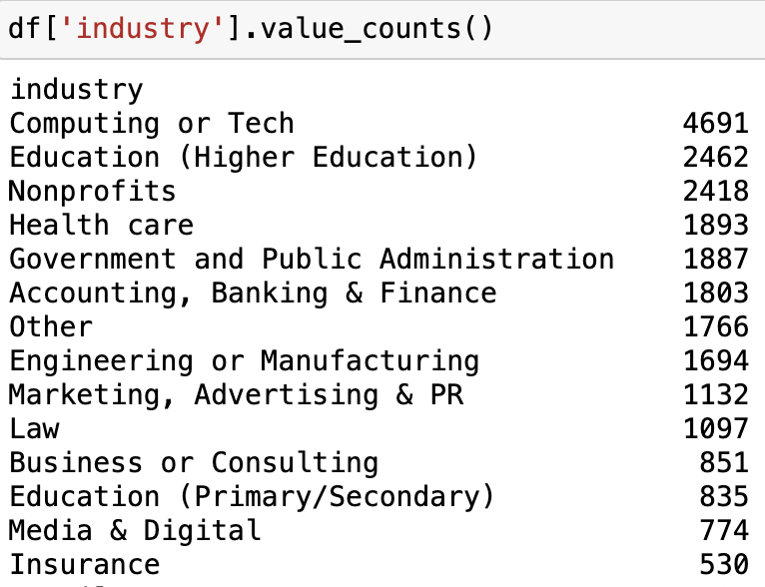
Label Encoding

Slide 14
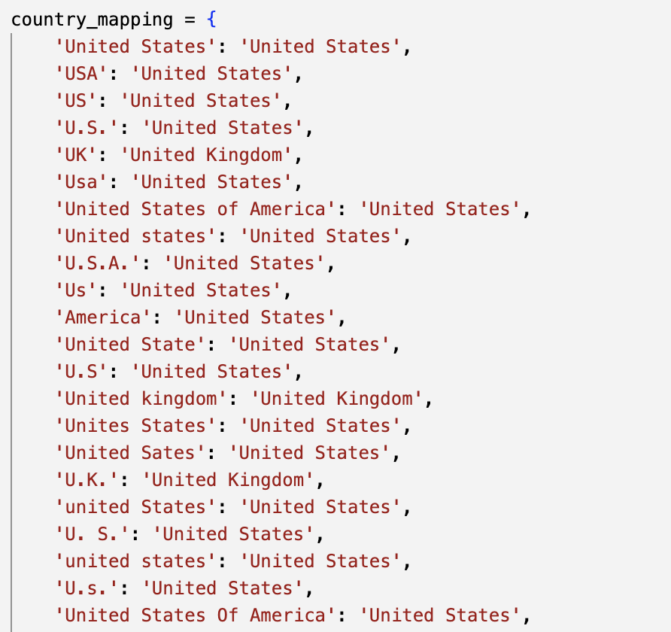
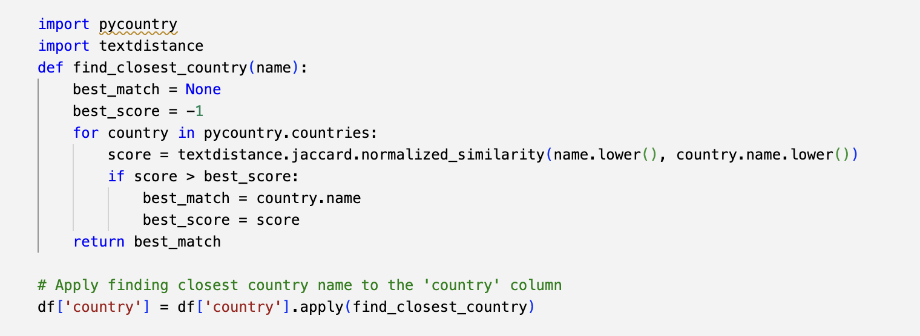
Standardization and Similarity metrics

Slide 15
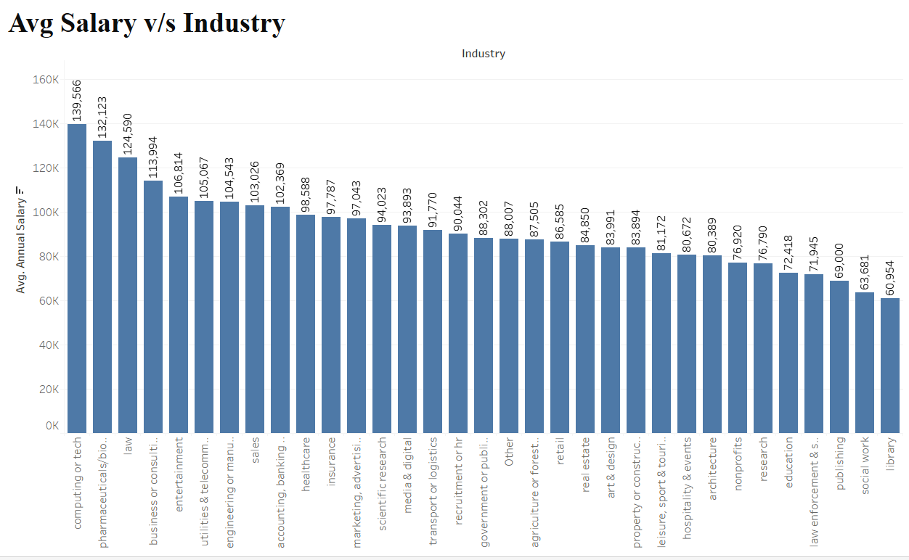
Which industry pays the most?
Highest Paying Computing or Tech ~ $ 140k
Lowest Paying Library ~ $ 70k

Slide 16
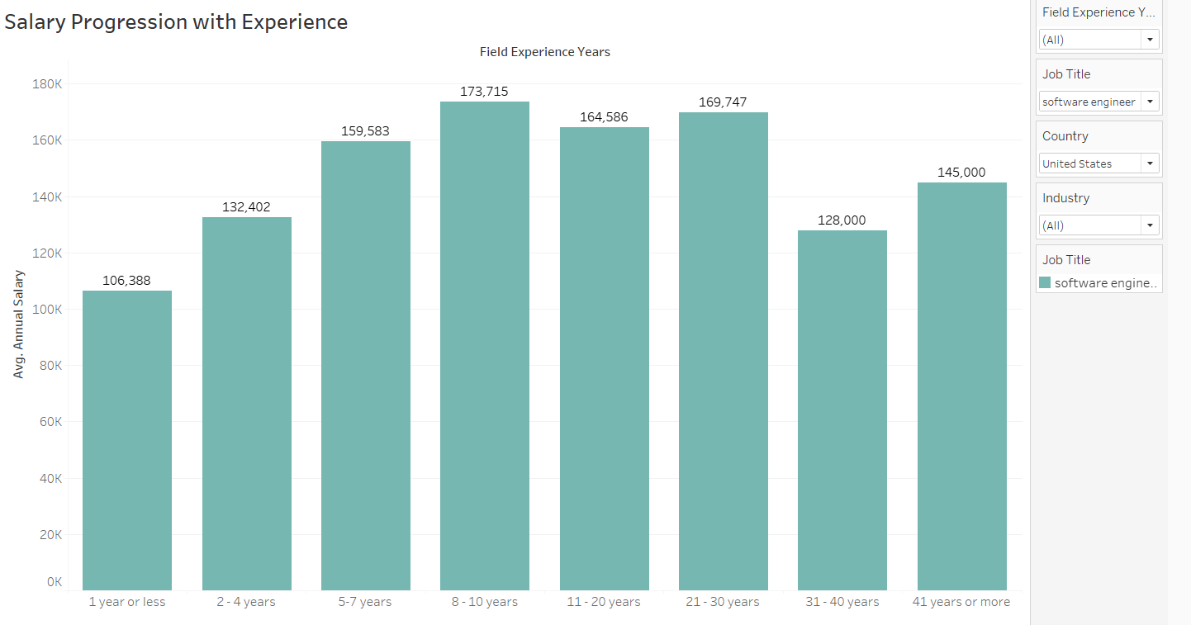
How does salary increase given years of experience?
Based on this graph, salary increases with linearly till 10 years of Experience, after that it seems to plateau.

Slide 17
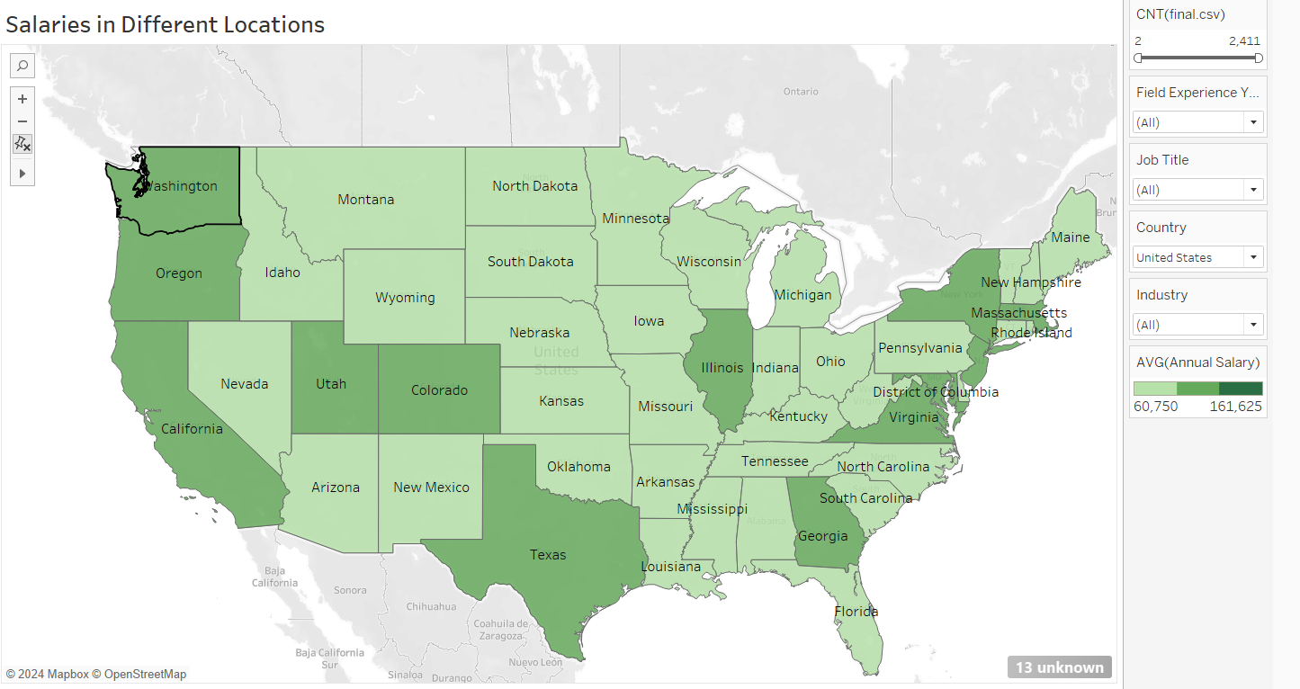
How do salaries compare for the same role in different locations?
Based on this map, salary hotspot appear to be California, New York and Washington, Texas, New York and Illinois. It does make sense as they are usually considered as big markets.

Slide 18
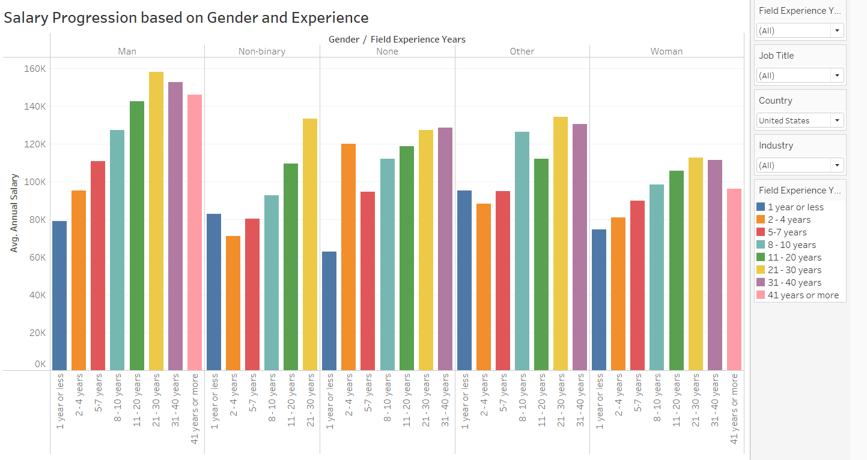
How much do salaries differ by gender and years of experience?
Based on this graph, salary increases linearly for all genders as expected.
While men and women start with comparable salaries at the start of their careers, it appears that men earn more compared to their counterpart as their field experience increases.

Slide 19
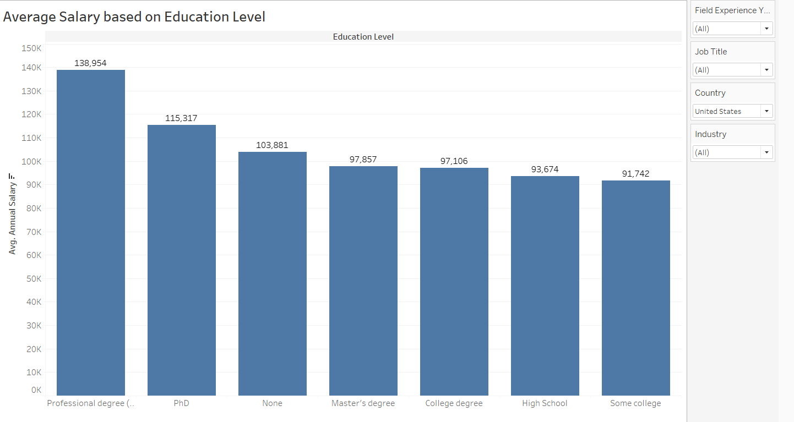
How do factors like education level correlate with salary?
As per this graph, A professional degree like JD, MD yields a high salary followed by PhD. What’s surprising to see is to only see a small difference between Bachelor’s and Master’s salaries. Also, people without degrees tend to earn well.

Slide 20
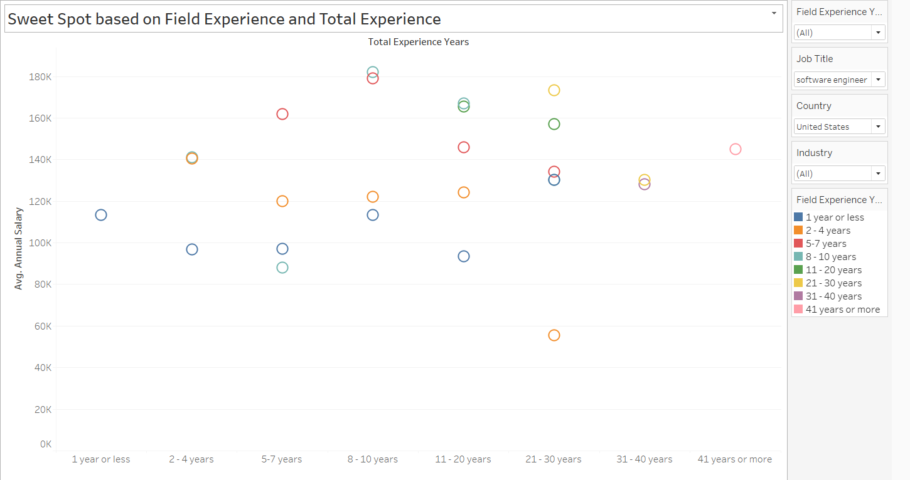
Is there a “sweet spot” total work experience vs years in the specific field?
Based on this scatter, the sweet spot is when you have 8-10 years of total experience in the same field you are working in. 5-7 years of field experience in 8-10 years of total experience yields a high salary

Slide 21
THANK YOU!

